Slide 1
Discovery of Two Genetic Functions Related to Cataractogenesis
Notes:
Oh yeah, change the title. This one is trash.

Slide 2
Abstract
Cataract is the leading cause of vision impairment in the world, and a non-surgical therapy would revolutionize the treatment of this illness. The root causes of cataract, and the functions involved within cataractogenesis, are still not fully elucidated. We collected cataract-related genes and interactions from online databases and mapped these interactions in Cytoscape. Then, we clustered the networks and analyzed the clusters in various tools, including functional analysis in IPA. This functional analysis yielded two previously unassociated factors that may play a role in the etiology of cataract.

Slide 3
Introduction

Slide 4
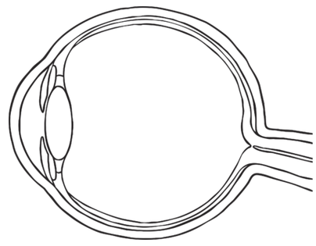
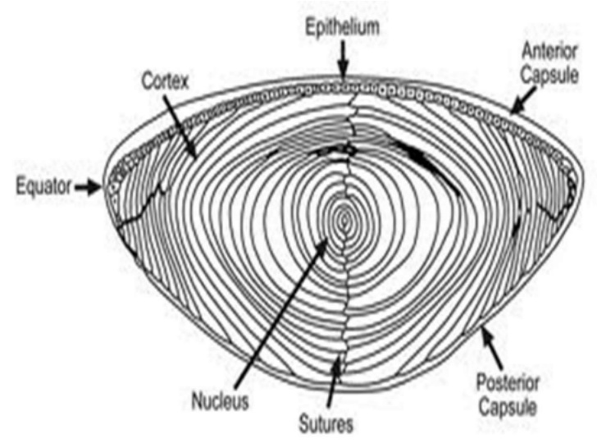
Eye and Lens
Lens is located in front of eye; its function is to focus incoming light onto the retina.
Three parts: capsule (outer elastic layer of cells), epithelium (cells that divide to produce fiber cells), fiber cells (clear, organelle-free cells)
To focus, we change the curvature of the lens

Slide 5
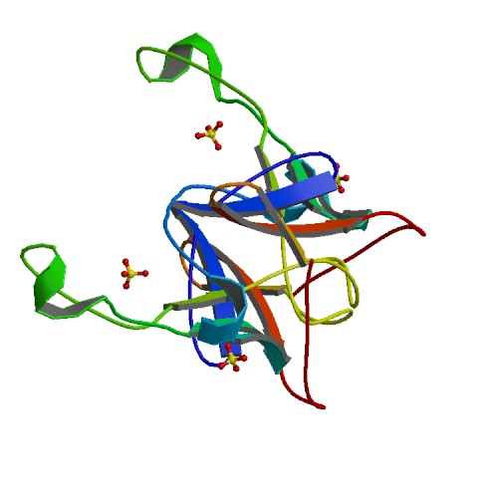
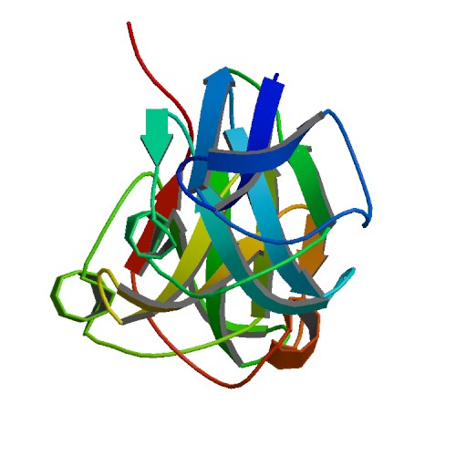
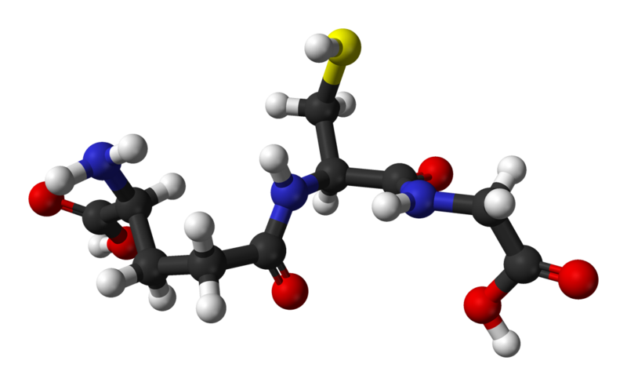
Fiber Cells and Crystallin
Fiber cells' protein: 90% crystallin
Three types:
α-crystallin: Structural protein and "chaperone" (binds to proteins to stabilize and prevent aggregation, but doesn't refold them). Two units: αA, αB
Encoded by CRYAA, CRYAB genes
β- and γ-crystallin: Structural protein, but otherwise no significant function
Encoded by CRYB*, CRYG* genes
Fiber cells are organelle-free; proteins are permanent.
Glutathione (GSH): Anti-oxidant, prevents oxidation of the crystallins.
Encoded by GSTM1, GSTT1 genes
Notes:
CRYBA1 CRYBA4 CRYBA4 CRYBB1 CRYBB2 CRYBB3 CRYBB3 CRYGA CRYGB

Slide 6
Cataract
Cataract is opacification of the lens; when the lens becomes cloudy and blocks vision
Opaque areas are aggregates of desolubilized crystallin proteins
Protein aggregation is caused by oxidation
Naturally over time: age-related cataract
As a result of high sugar concentration in the eye: diabetic cataract (or similar)
Through genetic mutations
Currently, only approved treatment is surgical replacement of the lens
Presents complications in areas with poor healthcare and/or low wealth
Leading cause of blindness worldwide
Estimated 17 million people with bilateral cataracts (Congdon et al, 2003)

Slide 7
Goals
Cataract is an immediate result of two factors:
Decrease of glutathione levels
Formation of lens barrier
Decreased recycling efficiency
Usage of α-crystallin
Limited supply; by age 40, no α-crystallin remains
Mutations in crystallin genes can result in nonfunctional α-crystallin
Goal:
Identify genetic pathways related to cataract formation
Pathways can be targeted by drugs to prevent or treat cataract (non-surgically)

Slide 8
Introduction
Cataract is the leading cause of visual impairment worldwide, with an estimated 17 million people affected by bilateral cataract (Congdon et al, 2003). Cataract results from aggregation of the crystallin proteins in the fiber cells of the eye lens, leading to opacification. The aggregation is a result of oxidation; with age, disease, or genetic mutation, reactive oxygen species can desolubilize the crystallins (Truscott, 2005). The α-crystallins of the eye perform a chaperone-like activity, stabilizing and resuspending these desolubilized proteins without truly renaturing them. As the fiber cells cannot produce their own proteins, this limited supply of α-crystallin is gradually depleted, with little to no α-crystallin remaining by age 50 (Horwitz et al, 1999). While the exact causes of cataract are not known, it is generally accepted that it is a multifactorial disease.
Currently, the only approved treatment for cataract is surgical replacement of the cloudy lens with an artificial one. This is infeasible among people of lower socioeconomic status or in areas with poor healthcare. A non-surgical control measure would thus greatly reduce the prevalence of cataract. To find or create a drug suitable for this role, one must first elucidate the genetic functions leading to the onset of cataract. It is difficult to obtain lenses for experimentation, and evidence suggests that the etiology of human cataract is different from that in other, more easily obtainable animals (Truscott, 2005). Thus, using computational tools can provide significant insight and illuminate possible targets for further study.

Slide 9









Function Analysis
Gene Collection
Gene Clustering
Pathway Analysis
Methods

Slide 10
Methods
Gene Collection
Gene Clustering
Cataract-related genes were collected from:
PubMed Gene
Using query “cataract & “homo sapiens”[Organism]”
Phenopedia
Genes found under Cataract disease
Gene collections were submitted separately to GeneFriends:RNASeq
GeneFriends-generated networks were mapped in Cytoscape
Clusters were identified via ClusterONE app with parameter “Haircut threshold” set to 0.05, all others left as default

Slide 11
Methods
Function Analysis
Pathway Analysis
Clusters were analyzed within Cytoscape using BinGO app
Yielded function results
Clusters were extracted from Cytoscape and processed in GeneOntology
Yielded function and disease connections
Clusters were processed in DAVID and Ingenuity to search for pathways

Slide 12
Methods
Initial gene collection was performed through PubMed Gene and Phenopedia (Yu et al, 2009). Individual gene lists from each source were compiled and submitted to GeneFriends RNASeq (Dam et al, 2012), and the resulting .SIF files were imported into Cytoscape (Shannon et al, 2003). The generated networks were processed using the ClusterONE app (Nepusz et al, 2012). The resulting clusters were processed using the BinGO app (Maere et al, 2005), and extracted from Cytoscape and processed with GeneOntology (Ashburner et al, 2000. Networks were generated through Ingenuity Pathway Analysis (Krämer et al, 2013), and pathways were analyzed in DAVID 6.8 (Huang et al, 2008).

Slide 13
Results

Slide 14
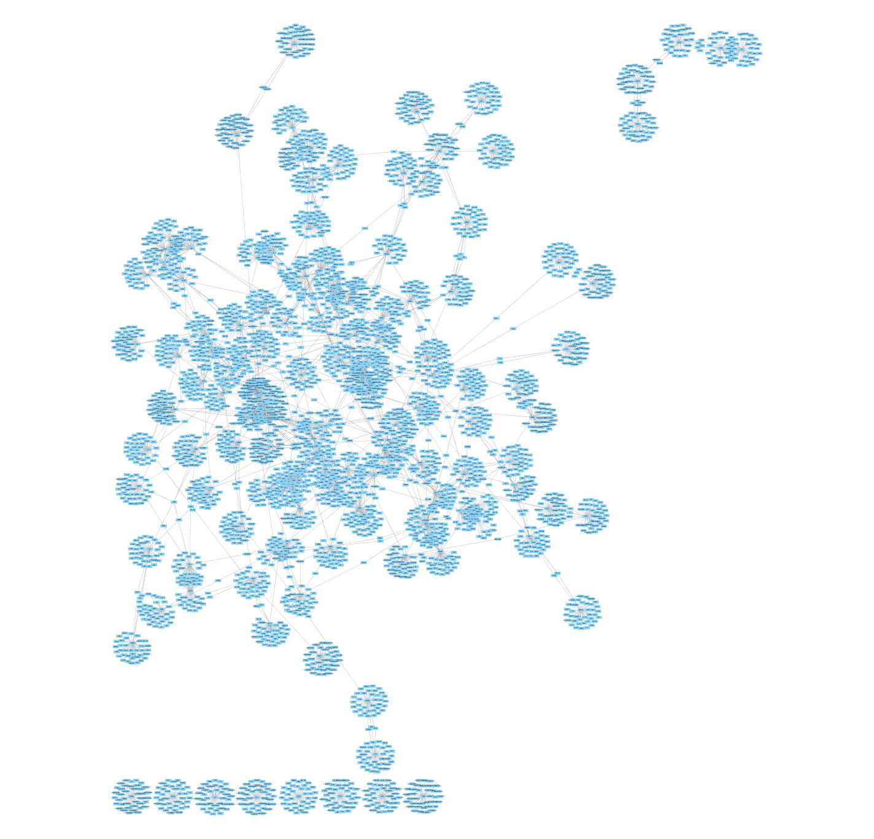
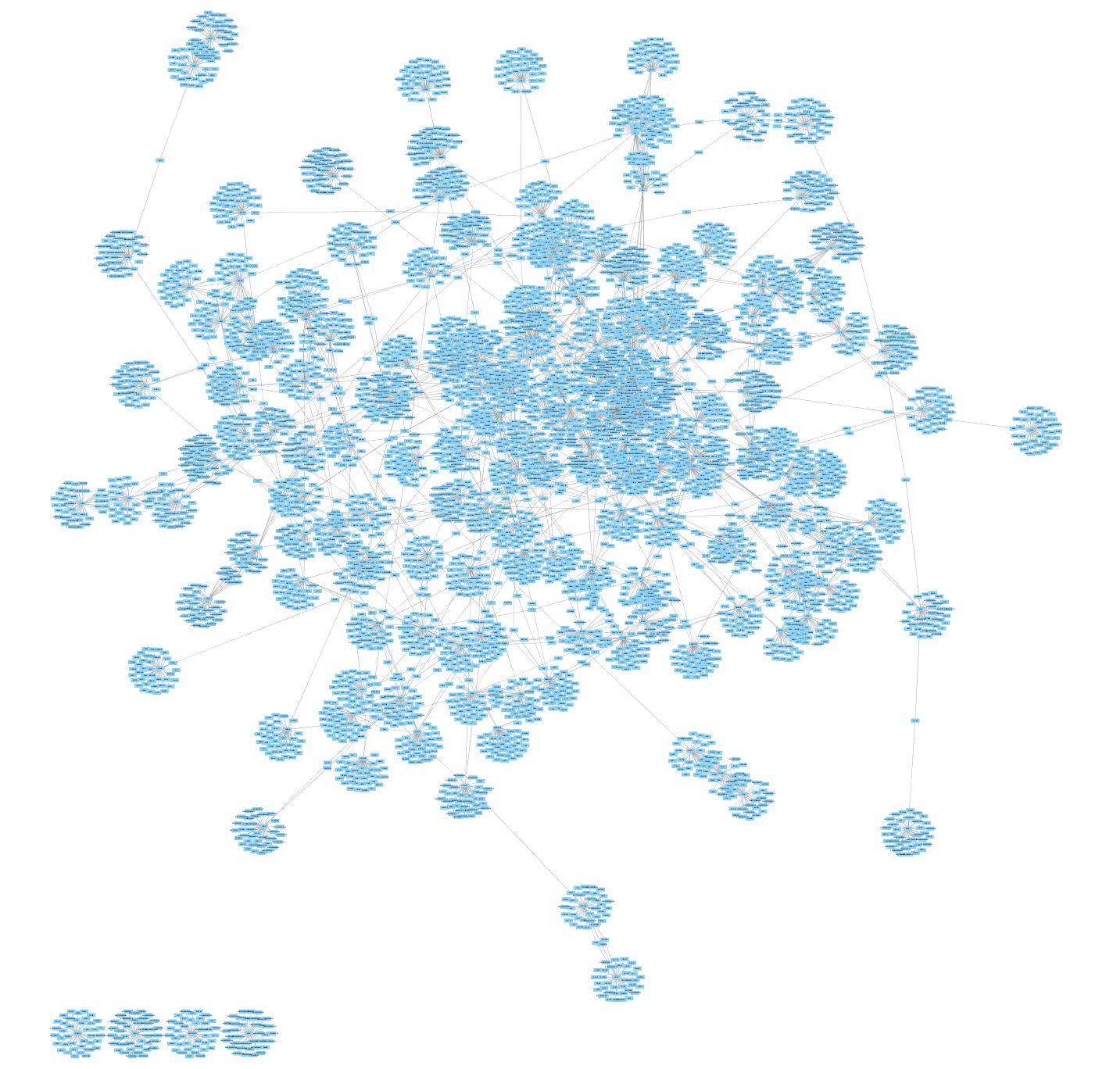
Networks
Phenopedia genes
PubMed genes
These are the two gene networks imported from GeneFriends into Cytoscape. The Phenopedia network contains 4366 genes, and the PubMed network contains 5592 genes.
Notes:
Shock and awe

Slide 15
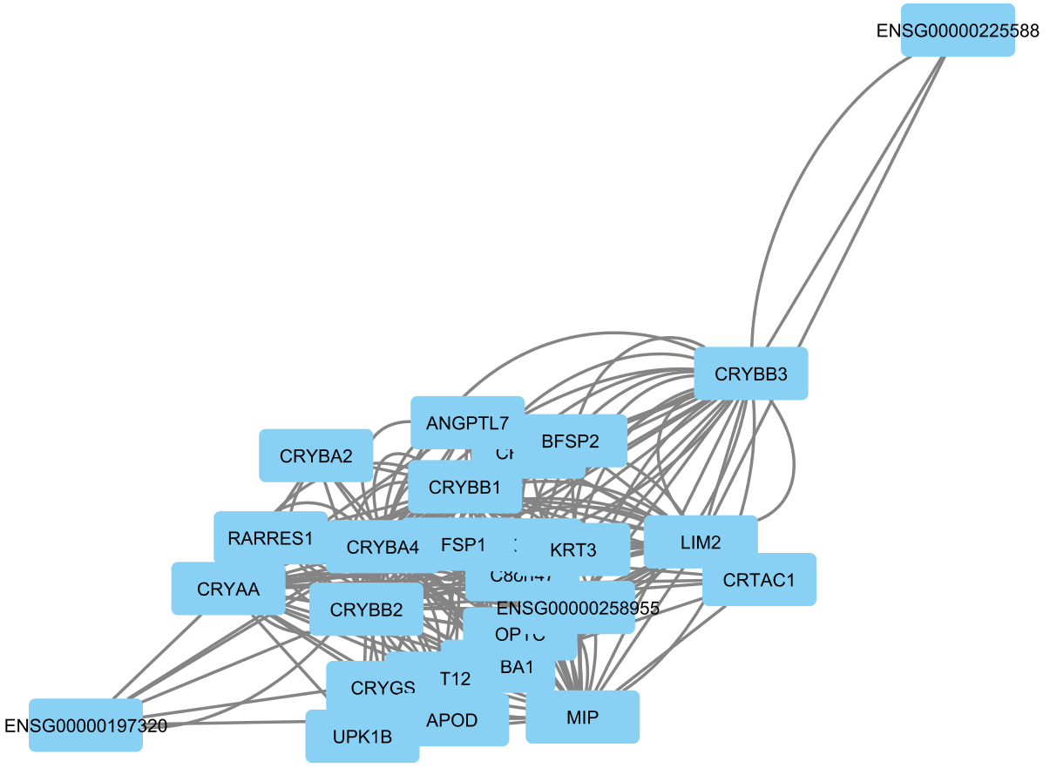
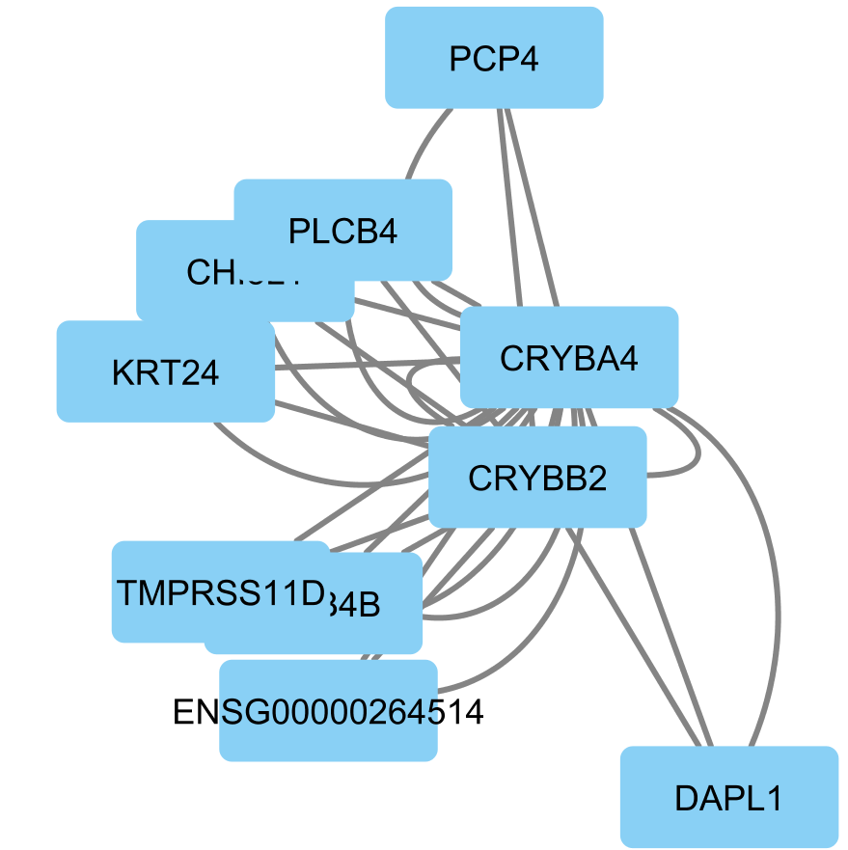
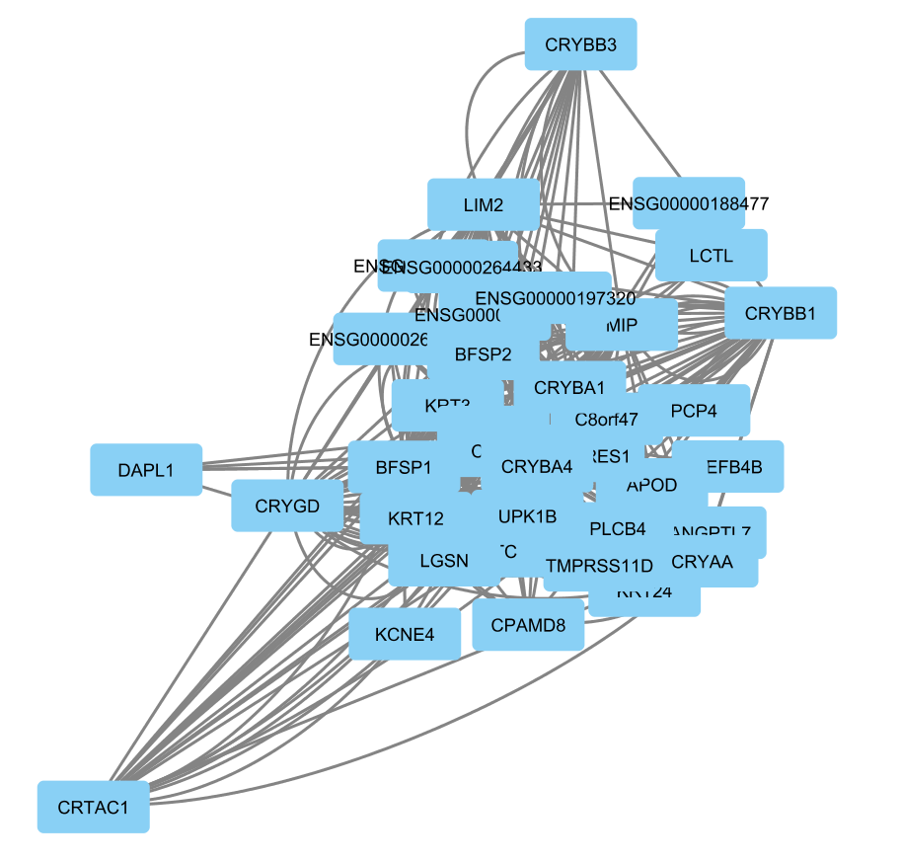
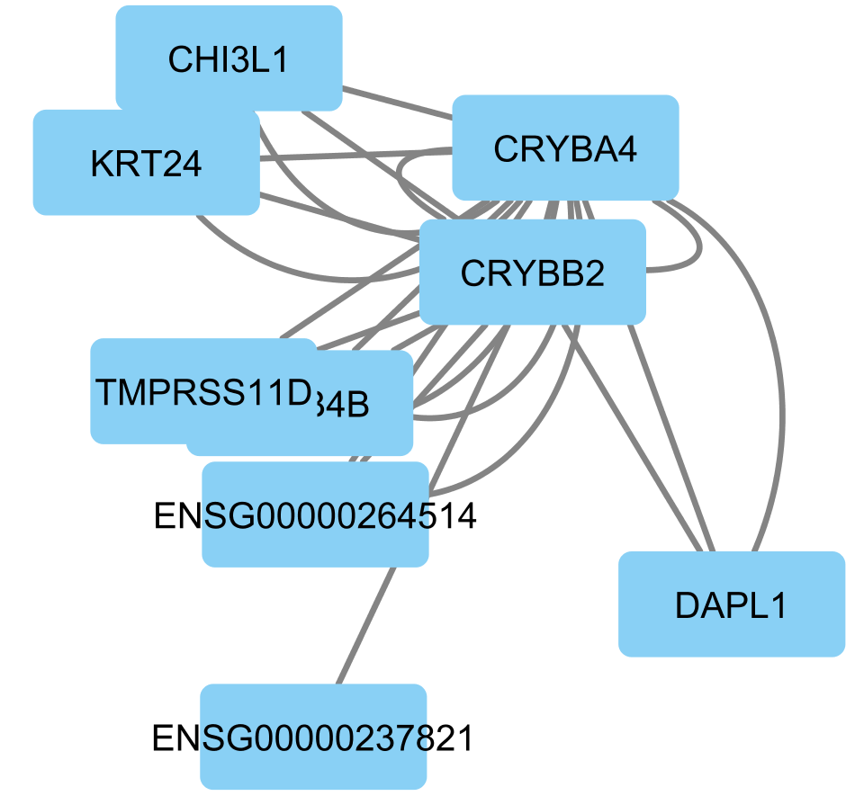
Clusters
Cluster 20
p=0.010
Cluster 7
p=2.896e-4
Cluster 8
p=7.329e-7
Cluster 21
p=0.021

Slide 16
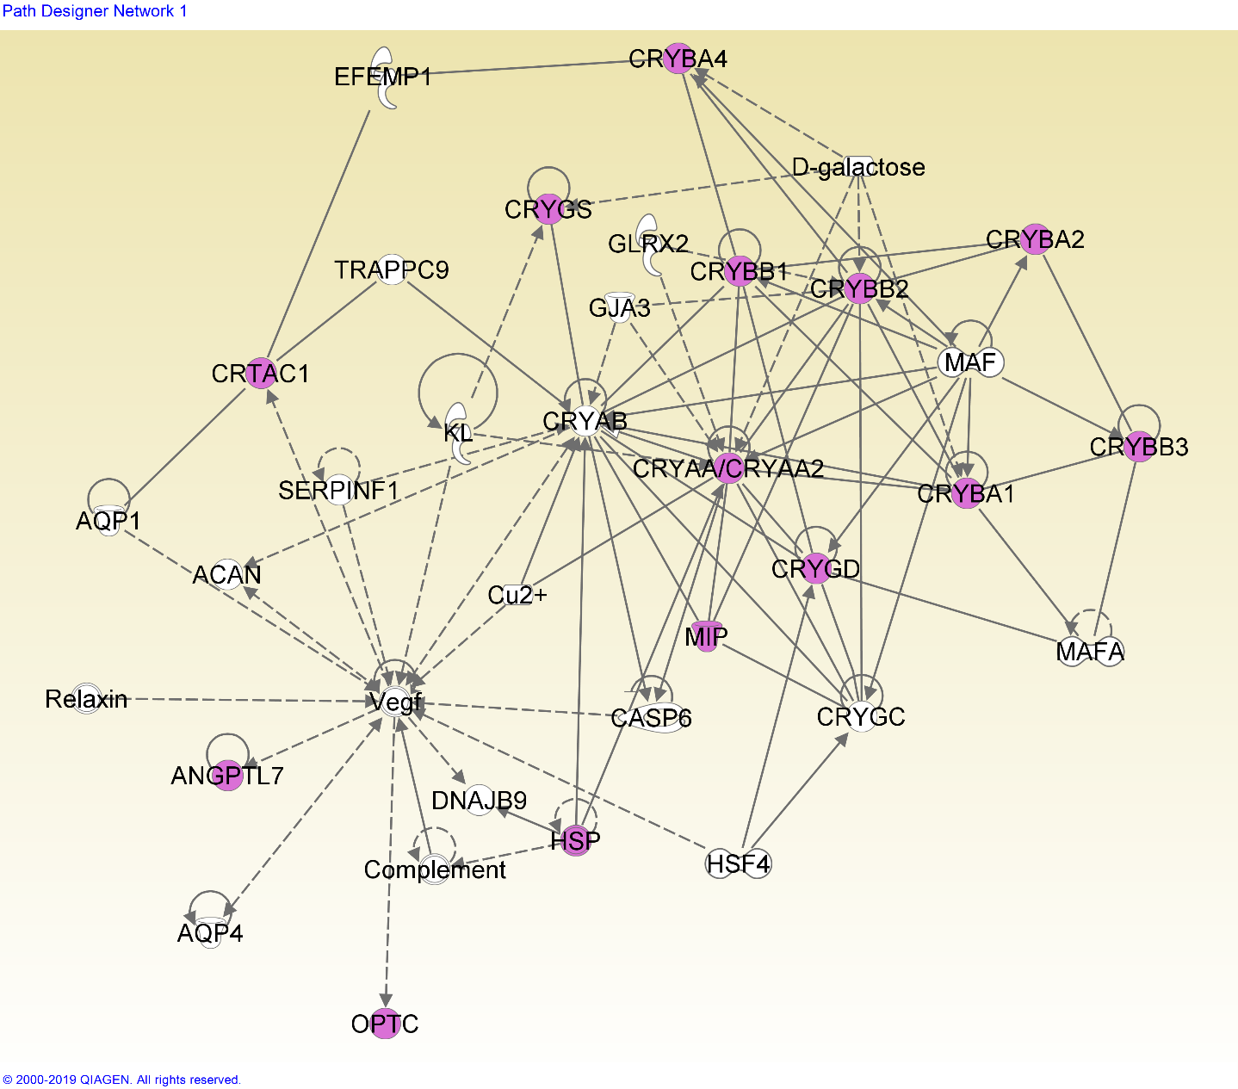
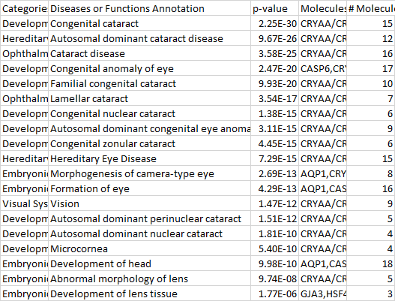
Network 7-1
A standard cataract-related network, with a minor focus on eye and head development and disorders.

Slide 17
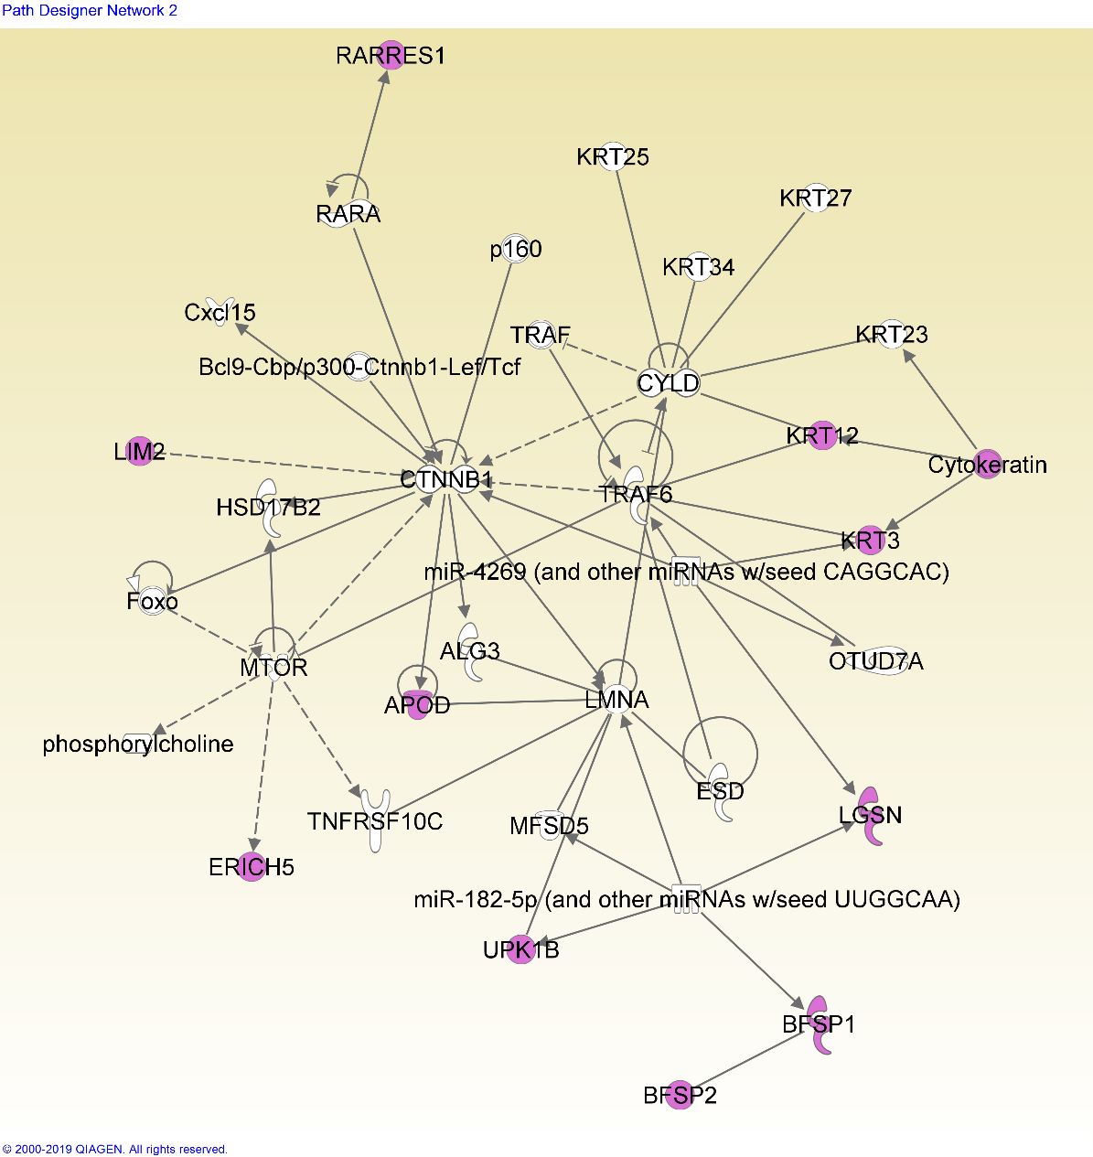
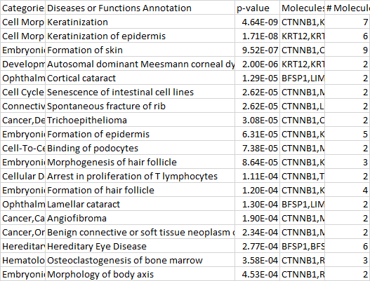
Network 7-2
This network shows many functions related to keratinization (insertion of keratin into skin/hair cells).
Keratin is present in the lens epithelium, and forms a significant part of its structural integrity (Quinlan et al, 1999). This network may imply that keratin in the epithelial and early fiber cells plays a role in later cataract formation.

Slide 18
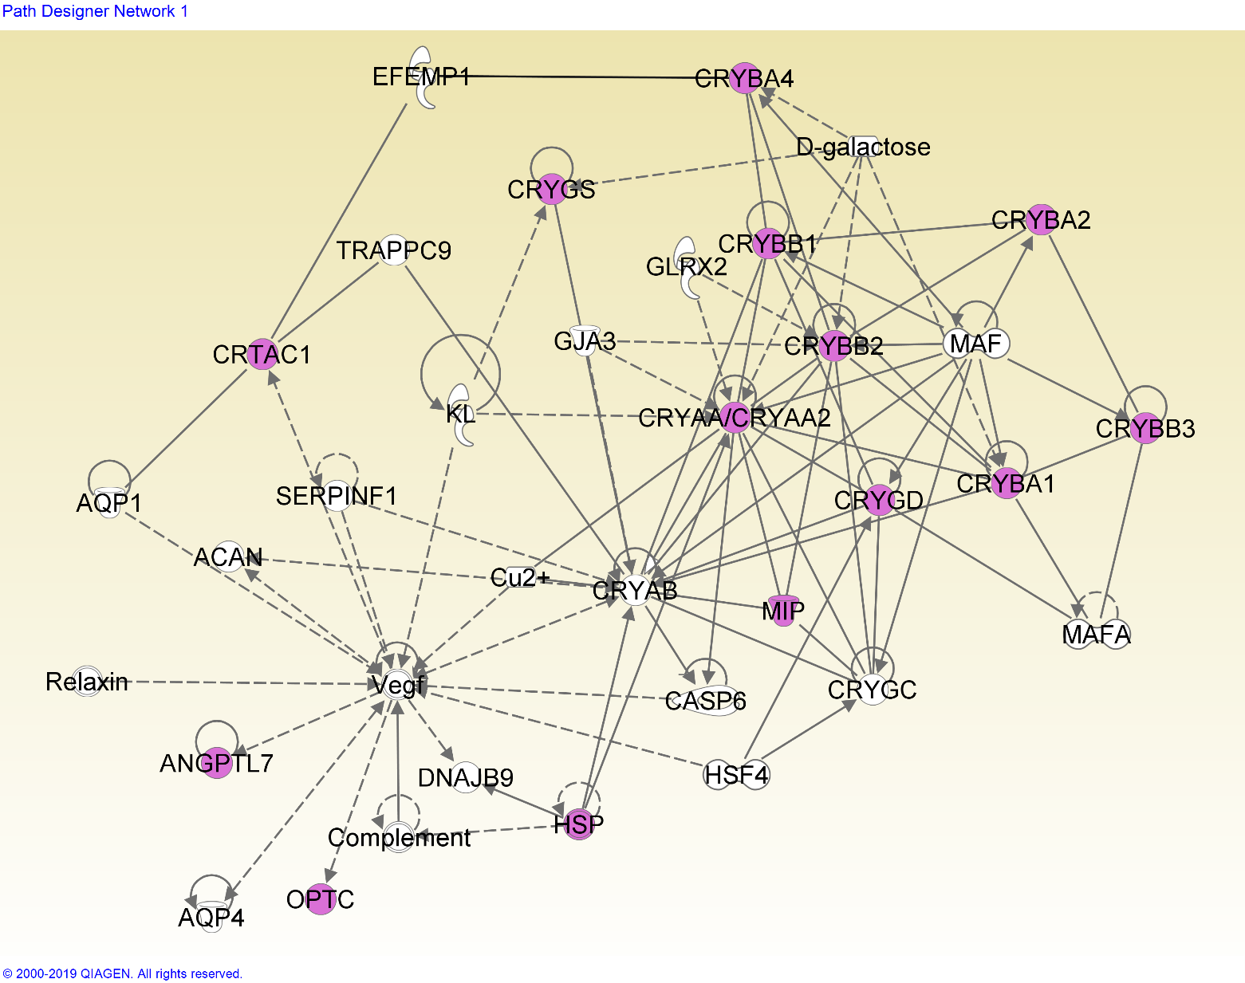
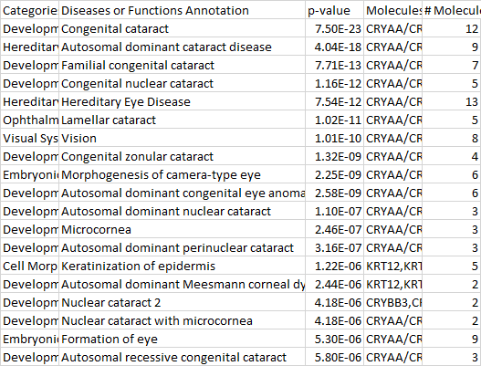
Network 8-1
The genes from cluster 8 fit into the same network as cluster 7. This cluster has a broader focus on eye development.

Slide 19
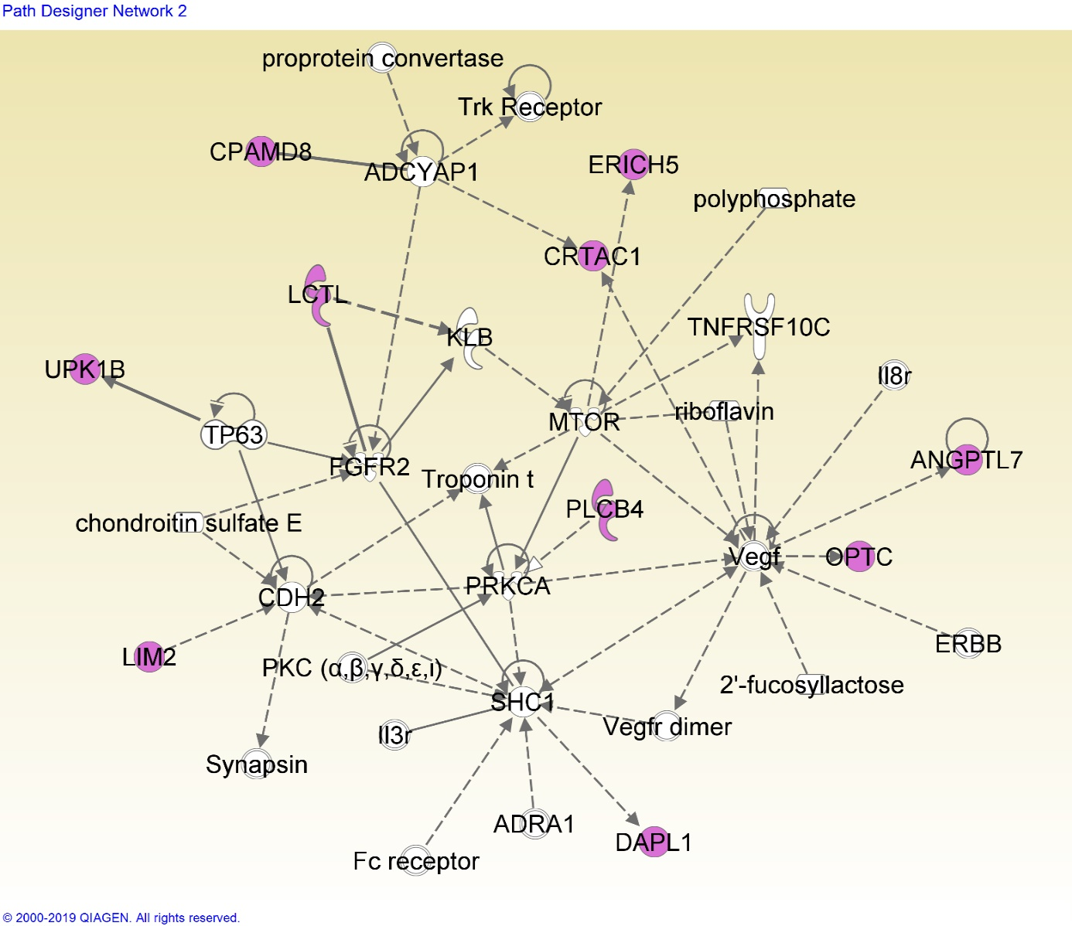
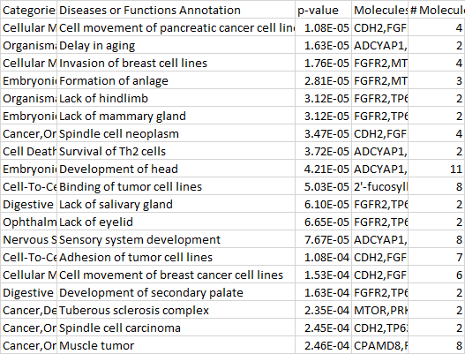
Network 8-2
This network is related with organ development.
Notes:
Organ development; overall, developmental functions

Slide 20
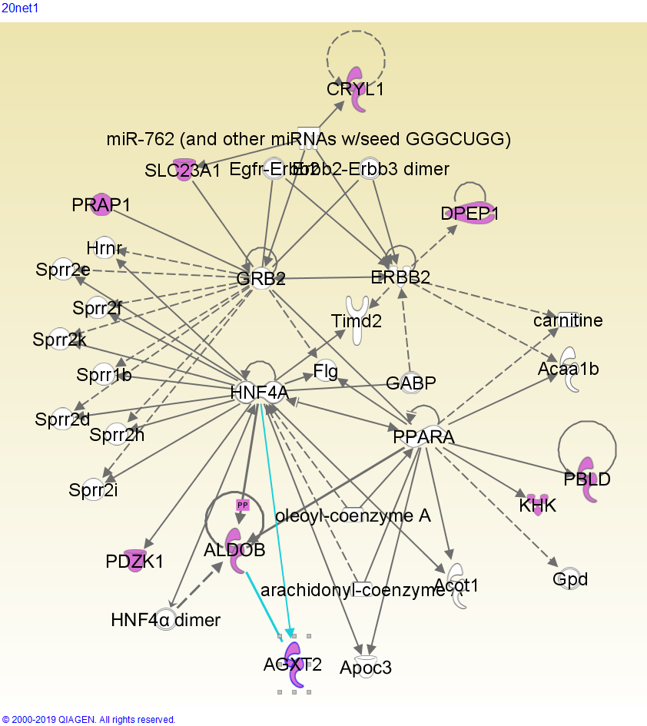
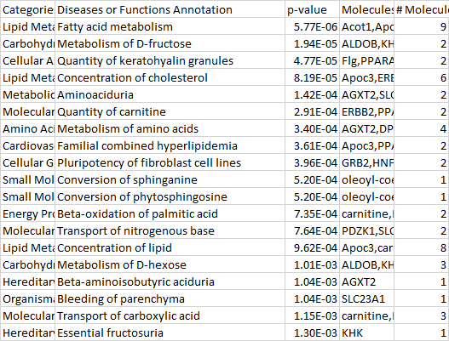
Network 20-1
A network related to metabolism, especially of sugars, fats, and amino acids. Fatty acids affect the expression of lutein, which is shown to prevent cataract formation (Padmanabha & Vallikannan, 2018); sugars are known to cause cataract, since an increased blood sugar concentration affects the concentration of the fiber cell cytoplasm (Pollreisz & Schmidt-Erfurth, 2010)

Slide 21
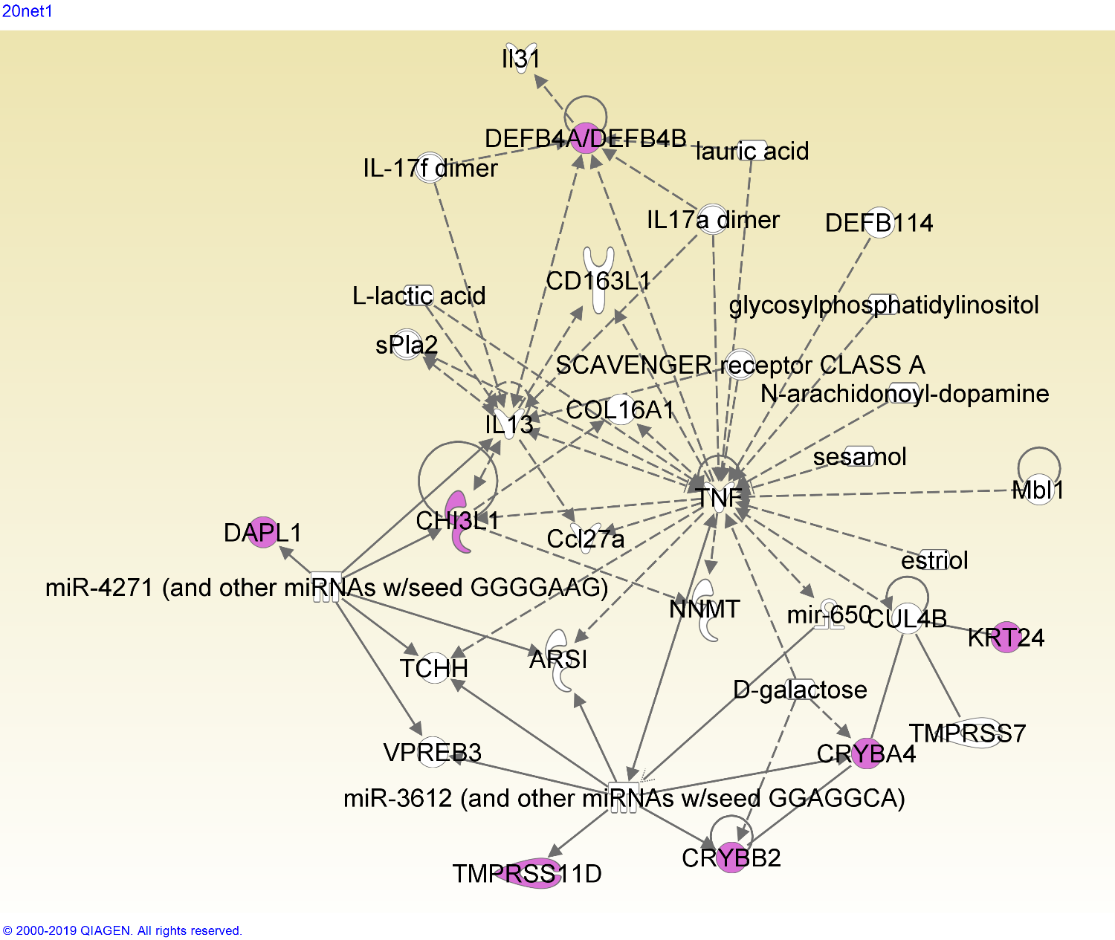
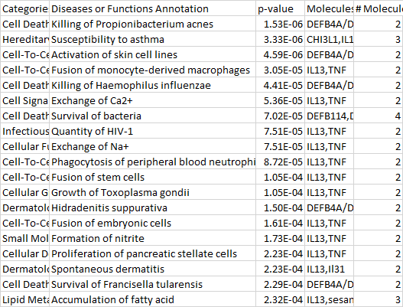
Network 21-1
This network is heavily centered around the TNF (tumor necrosis factor) gene, which has many functions varying from tissue regeneration to apoptosis (Wajant, et al).

Slide 22
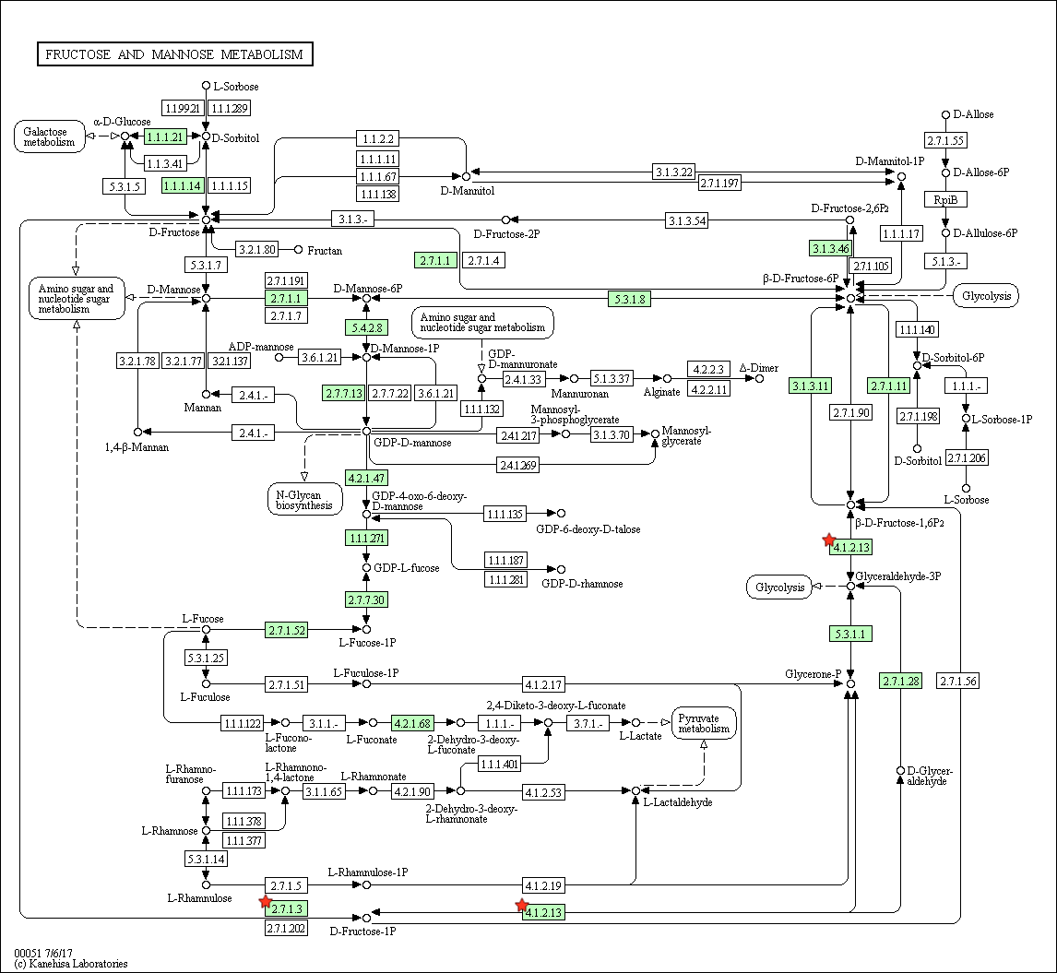
Cluster 20 – fructose metabolism pathway
It has been shown that within non-diabetic patients, fructose levels are higher in those with senile cataract than those without (Gul et al, 2009). This pathway further confirms the finding.
Notes:
Fructose = sugar = related; emphasize more and downplay the fact that there’s only three (two) genes

Slide 23
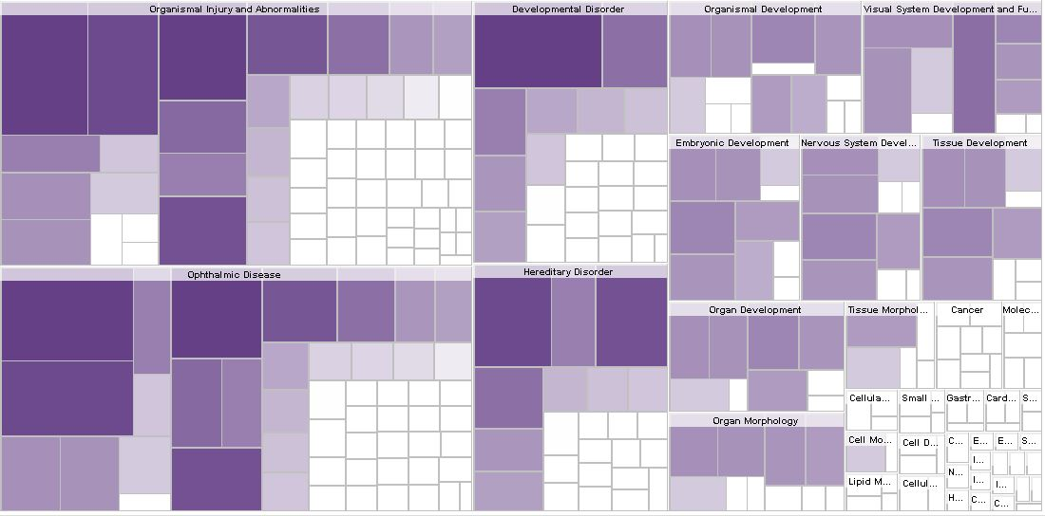

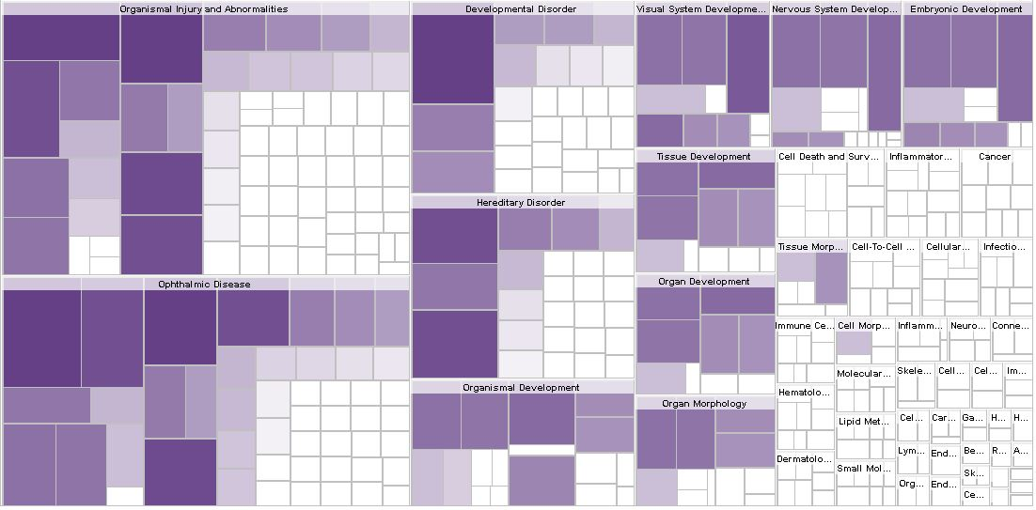

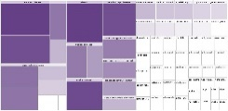
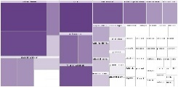
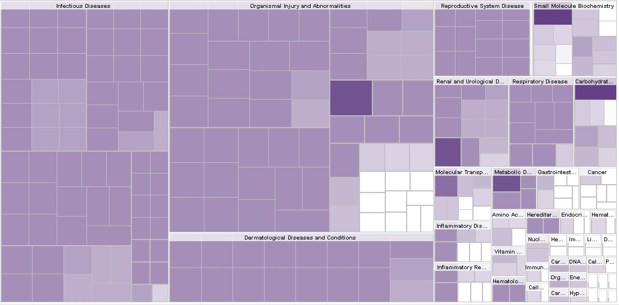

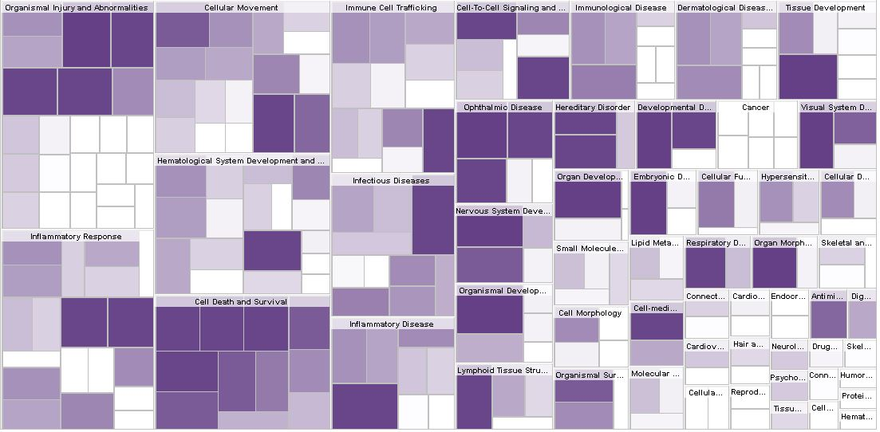



Cluster 7 disease/function maps. Small maps represent “ophthalmic disease” and “organismal injury and abnormalities”, respectively
Cluster 8 disease/function maps. Small maps represent “ophthalmic disease” and “organismal injury and abnormalities”, respectively
Cluster 20 disease/function map. Small map represents “small molecule biochemistry”, and the significant square represents “Metabolism of D-galactose”.
Cluster 21 disease/function maps. Small maps represent “ophthalmic disease”, “organismal injury and abnormalities”, and “cellular migration”, respectively
Notes:
Label ._.

Slide 24
Discussion

Slide 25

Networks
The prevalence of keratin genes and keratin-related functions within this network implies that keratin genes play a role in cataractogenesis. As previously stated, keratin is found in lens epithelial and young fiber cells, and this presence may leave structural and/or chemical remnants that lead to development of cataract.
Other genes here (LIM2, BFSP1, BFSP2) also encode lens structural proteins, reinforcing the hypothesis that the structural protein keratin is associated with cataract.
Network 7-2

Slide 26

Networks
TNF affects many of the genes in this network; it causes an increase in DEFB4A/DEFB4B and CHI3L1 genes, and it and CRYBA4/CRYBB2 are both impacted by D-galactose.
The DEFB4 genes encode defensin antimicrobial protein, and CHI3L1 encodes a chitin-hydrolysing enzyme; this may mean that antimicrobial pathways play a role in cataract, and may even imply that cataract is affected by microbial factors.
Network 21-1

Slide 27
Discussion
Of the 6 networks generated in IPA, three networks were related to expected cataract related functions, and one was found to describe broader organ development. Two of the networks, Network 7-2 and Network 21-1, demonstrate novel functions.
The prevalence of keratin genes and keratin-related functions within Network 7-2 implies that keratin genes play a role in cataractogenesis. Keratin is found in lens epithelial and young fiber cells (Quinlan et al, 1999), acting as a structural protein in the developing cell. This presence may leave structural and/or chemical remnants that lead to development of cataract. Other genes in this network (LIM2, BFSP1, BFSP2) also encode lens structural proteins, reinforcing the hypothesis that the network is related to cell structure, and the structural protein keratin is associated with cataract.
TNF affects many of the genes in Network 21-1; it causes an increase in DEFB4A/DEFB4B and CHI3L1 genes, and it and CRYBA4/CRYBB2 are both impacted by D-galactose. The DEFB4 genes encode defensin antimicrobial protein, and CHI3L1 encodes a chitin-hydrolysing enzyme; this may mean that antimicrobial pathways play a role in cataract, and may even imply that cataract is affected by microbial factors.

Slide 28
Conclusion
We have found two functions previously unassociated with cataractogenesis. The impact of keratin on epithelial and fiber cells may be an important factor in cataract formation during old age. In addition, the action of TNF genes and their impact on other genes may also influence cataract. Of course, further investigation is needed to confirm these links.
Cataract remains a highly prevalent problem around the world. Further elucidation of the causes and pathways leading to cataract can lead to development of therapies and treatments aimed at these causes, helping to prevent and ultimately treat cataracts non-surgically. Such a breakthrough will have large impacts on cataract prevalence, especially in third-world countries and among people with poor healthcare or socioeconomic status.

Slide 29
Citations
Congdon, Nathan G. “Important Causes of Visual Impairment in the World Today.” JAMA, vol. 290, no. 15, 15 Oct. 2003, pp. 2057–2060., doi:10.1001/jama.290.15.2057.
Horwitz, Joseph, et al. “Lens α-Crystallin: Function and Structure.” Eye, vol. 13, no. 3, 1999, pp. 403–408., doi:10.1038/eye.1999.114.
Padmanabha, Smitha, and Baskaran Vallikannan. “Fatty Acids Modulate the Efficacy of Lutein in Cataract Prevention: Assessment of Oxidative and Inflammatory Parameters in Rats.” Biochemical and Biophysical Research Communications, vol. 500, no. 2, 2 June 2018, pp. 435–442., doi:10.1016/j.bbrc.2018.04.098.
Pollreisz, Andreas, and Ursula Schmidt-Erfurth. “Diabetic Cataract—Pathogenesis, Epidemiology and Treatment.” Journal of Ophthalmology, vol. 2010, 2 Apr. 2010, pp. 1–8., doi:10.1155/2010/608751.
Quinlan, R A, et al. “The Eye Lens Cytoskeleton.” Eye, vol. 13, no. 3, May 1999, pp. 409–416., doi:10.1038/eye.1999.115.
Truscott, Roger J.w. “Age-Related Nuclear Cataract—Oxidation Is the Key.” Experimental Eye Research, vol. 80, no. 5, 26 Feb. 2005, pp. 709–725., doi:10.1016/j.exer.2004.12.007.
Wajant, H, et al. “Tumor Necrosis Factor Signaling.” Cell Death & Differentiation, vol. 10, no. 1, 2003, pp. 45–65., doi:10.1038/sj.cdd.4401189.

Slide 30
Citations (new)
Ashburner, Michael, et al. “Gene Ontology: Tool for the Unification of Biology.” Nature Genetics, vol. 25, no. 1, May 2000, pp. 25–29., doi:10.1038/75556.
Congdon, Nathan G. “Important Causes of Visual Impairment in the World Today.” JAMA, vol. 290, no. 15, 15 Oct. 2003, pp. 2057–2060., doi:10.1001/jama.290.15.2057.
Dam, Sipko Van, et al. “GeneFriends: An Online Co-Expression Analysis Tool to Identify Novel Gene Targets for Aging and Complex Diseases.” BMC Genomics, vol. 13, no. 1, 6 Oct. 2012, p. 535., doi:10.1186/1471-2164-13-535.
Gene [Internet]. Bethesda (MD): National Library of Medicine (US), National Center for Biotechnology Information; 2004 – cited 2019 Jun 27. Available from: https://www.ncbi.nlm.nih.gov/gene/
Gul, Anjuman, et al. “Role of Fructose Concentration on Cataractogenesis in Senile Diabetic and Non-Diabetic Patients.” Graefe's Archive for Clinical and Experimental Ophthalmology, vol. 247, no. 6, 6 Feb. 2009, pp. 809–814., doi:10.1007/s00417-008-1027-9.
Horwitz, Joseph, et al. “Lens α-Crystallin: Function and Structure.” Eye, vol. 13, no. 3, 1999, pp. 403–408., doi:10.1038/eye.1999.114.
Huang, Da Wei, et al. “Bioinformatics Enrichment Tools: Paths toward the Comprehensive Functional Analysis of Large Gene Lists.” Nucleic Acids Research, vol. 37, no. 1, 25 Nov. 2008, pp. 1–13., doi:10.1093/nar/gkn923.
Huang, Da Wei, et al. “Systematic and Integrative Analysis of Large Gene Lists Using DAVID Bioinformatics Resources.” Nature Protocols, vol. 4, no. 1, 18 Dec. 2008, pp. 44–57., doi:10.1038/nprot.2008.211.
Krämer, Andreas, et al. “Causal Analysis Approaches in Ingenuity Pathway Analysis.” Bioinformatics, vol. 30, no. 4, 13 Dec. 2013, pp. 523–530., doi:10.1093/bioinformatics/btt703.
Maere, Steven, et al. “BiNGO: a Cytoscape Plugin to Assess Overrepresentation of Gene Ontology Categories in Biological Networks.” Bioinformatics, vol. 21, no. 16, 21 Mar. 2005, pp. 3448–3449., doi:10.1093/bioinformatics/bti551.
Nepusz, Tamás, et al. “Detecting Overlapping Protein Complexes in Protein-Protein Interaction Networks.” Nature Methods, vol. 9, no. 5, 18 Mar. 2012, pp. 471–472., doi:10.1038/nmeth.1938.
Padmanabha, Smitha, and Baskaran Vallikannan. “Fatty Acids Modulate the Efficacy of Lutein in Cataract Prevention: Assessment of Oxidative and Inflammatory Parameters in Rats.” Biochemical and Biophysical Research Communications, vol. 500, no. 2, 2 June 2018, pp. 435–442., doi:10.1016/j.bbrc.2018.04.098.
Pollreisz, Andreas, and Ursula Schmidt-Erfurth. “Diabetic Cataract—Pathogenesis, Epidemiology and Treatment.” Journal of Ophthalmology, vol. 2010, 2 Apr. 2010, pp. 1–8., doi:10.1155/2010/608751.
Quinlan, R A, et al. “The Eye Lens Cytoskeleton.” Eye, vol. 13, no. 3, May 1999, pp. 409–416., doi:10.1038/eye.1999.115.
Shannon, Paul, et al. “Cytoscape: A Software Environment for Integrated Models of Biomolecular Interaction Networks.” Genome Research, vol. 13, no. 11, 1 Nov. 2003, pp. 2498–2504., doi:10.1101/gr.1239303.
The Gene Ontology Consortium. “The Gene Ontology Resource: 20 Years and Still GOing Strong.” Nucleic Acids Research, vol. 47, no. D1, 8 Jan. 2018, pp. D330–D338., doi:10.1093/nar/gky1055.
Truscott, Roger J.w. “Age-Related Nuclear Cataract—Oxidation Is the Key.” Experimental Eye Research, vol. 80, no. 5, 26 Feb. 2005, pp. 709–725., doi:10.1016/j.exer.2004.12.007.
Yu, W., et al. “Phenopedia and Genopedia: Disease-Centered and Gene-Centered Views of the Evolving Knowledge of Human Genetic Associations.” Bioinformatics, vol. 26, no. 1, 27 Oct. 2009, pp. 145–146., doi:10.1093/bioinformatics/btp618.

